Slide 1

Analysing Region wise E-commerce Data using IBM Cognos dashboard
PRESENTATED BY :
TEAM NO:0003
18UK1A0506- B.Sadhana
18UK1A0519- G.Anjali
18UK1A0543-P. Akshay
18UK1A0558- T.Nikhitha

Slide 2
OUTLINE:
INTRODUCTION
OBJECTIVE
IBM CLOUD
IBM CONGOS ANALYTICS
WORKING WITH THE DATASET
DATA VISUALIZATION CAHRTS
CREATING DASHBOARD
EXPORT THE ANALYSIS
CONCLUSION

Slide 3
INTRODUCTION
With the increase in consumer demand , the E-commerce space has boomed. This also leads to an increase in fierce competition in today's online marketplace.
The ecommerce industry sells a diverse product line of grocery items and merchandise products, such as food, pharmaceuticals, apparel, games and toys, hobby items, furniture and appliances.
The analysis of such industry is of great importance as it gives insights for the sales and profits of various products.

Slide 4
OBJECTIVE
The various objectives of the e-commerce can be laid down as follows:
Development of Business-Relationship: The business development can be done through the e-commerce being the primary and the basic object. As their direct contact in between the company and the consumer, their business relationship will be enhanced.
By the end of this project you will :
know fundamental concepts and can work on IBM Cognos Analytics.
Gain a broad understanding of plotting different graphs.
Able to create meaningful dashboards

Slide 5
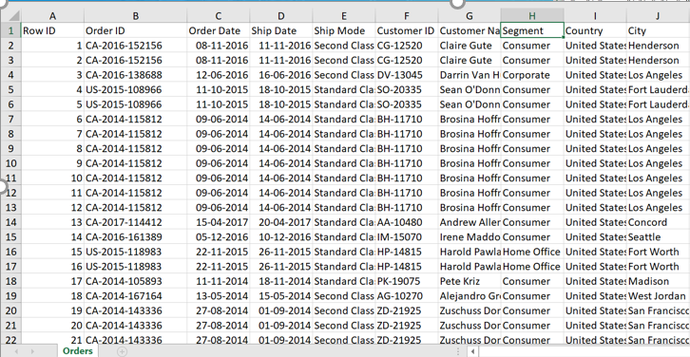
DATA
Analysing Region wise E-commerce Data using IBM Cognos dashboard
Data set consists of :
It has 9994 points (rows) and 21 features (columns) describing the results of E-Commerce
ROW ID
ORDER ID
SHIP DATE
SHIP MODE
CUSTOMER ID
SEGMENT
COUNTRY
CITY
REGION
PRODUCT
QUANTITY
DATA SOURCE : INTERNET

Slide 6
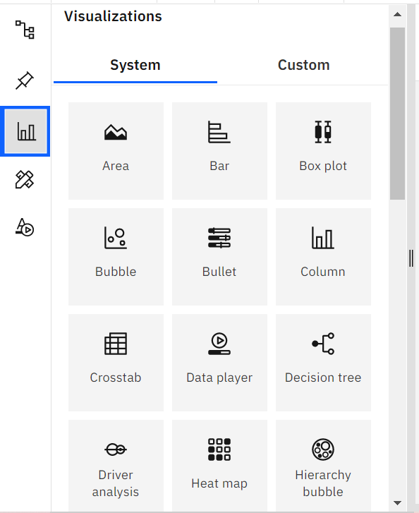
DATA VISUALIZATION
Data visualization is where a given dataset is presented in a graphical format.
It helps the detection of patterns, trends and correlations that might go and detected in test based data.
Using the e commerce dataset we plan to create various graphs and charts to highlet the insights and visualizations.
To visualize the dataset we need IBM Cognos Analytics Dashboard.
This dashboard contains different visualization such as PIE,POINT,COLUMN,BAR,BOXPLOT,BUBBLE ETC

Slide 7
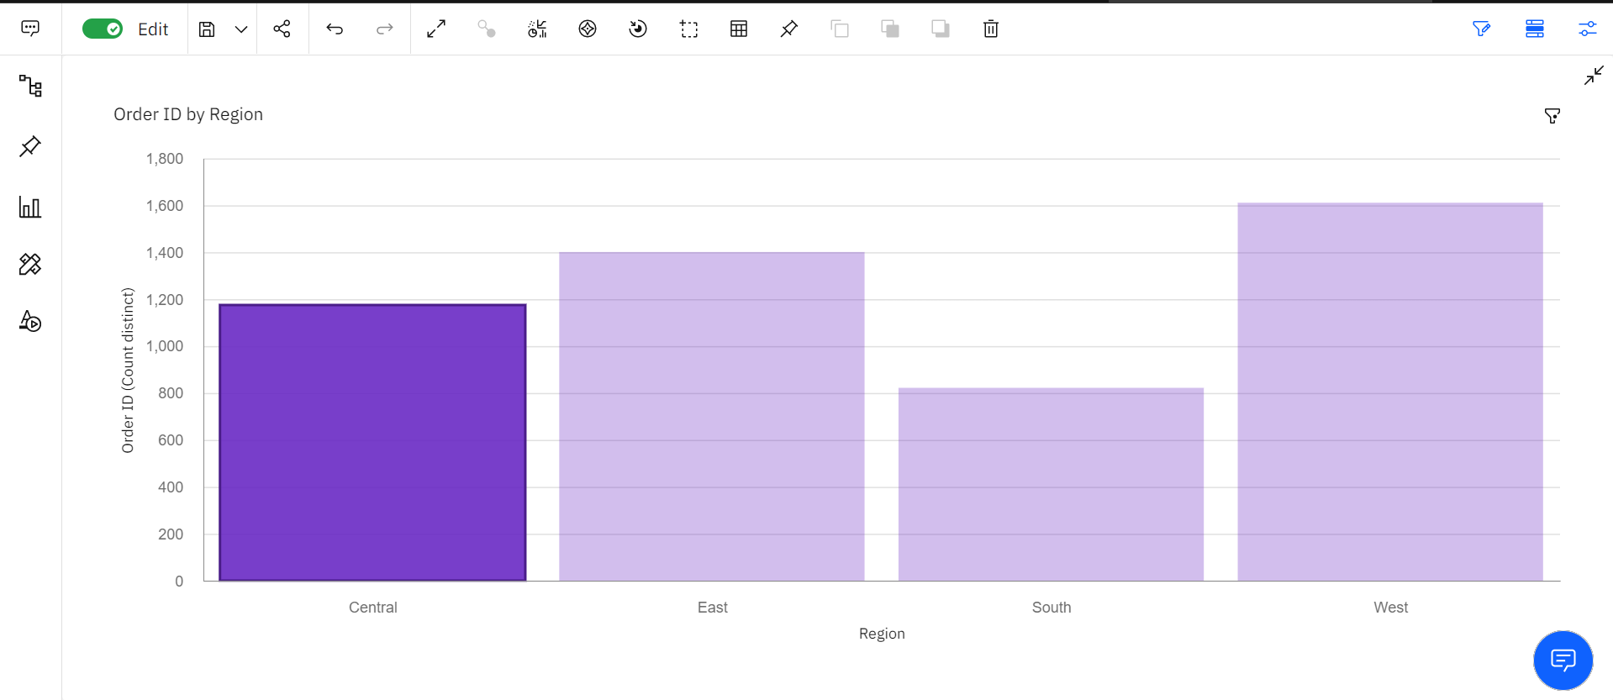
DATA VISUALIZATION CHART
Region that accounts for greater number of orders

Slide 8
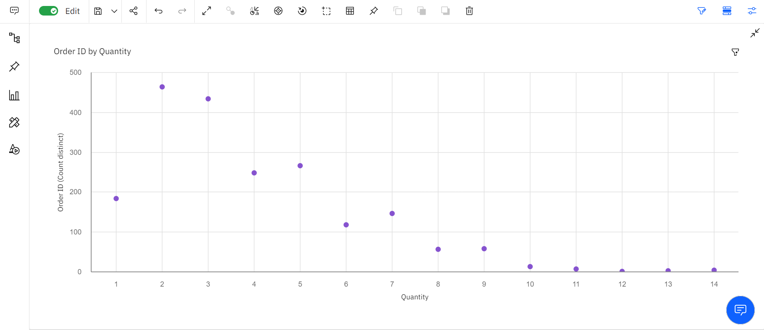
DATA VISUALIZATION CHART
Frequency distribution of quantity ordered

Slide 9
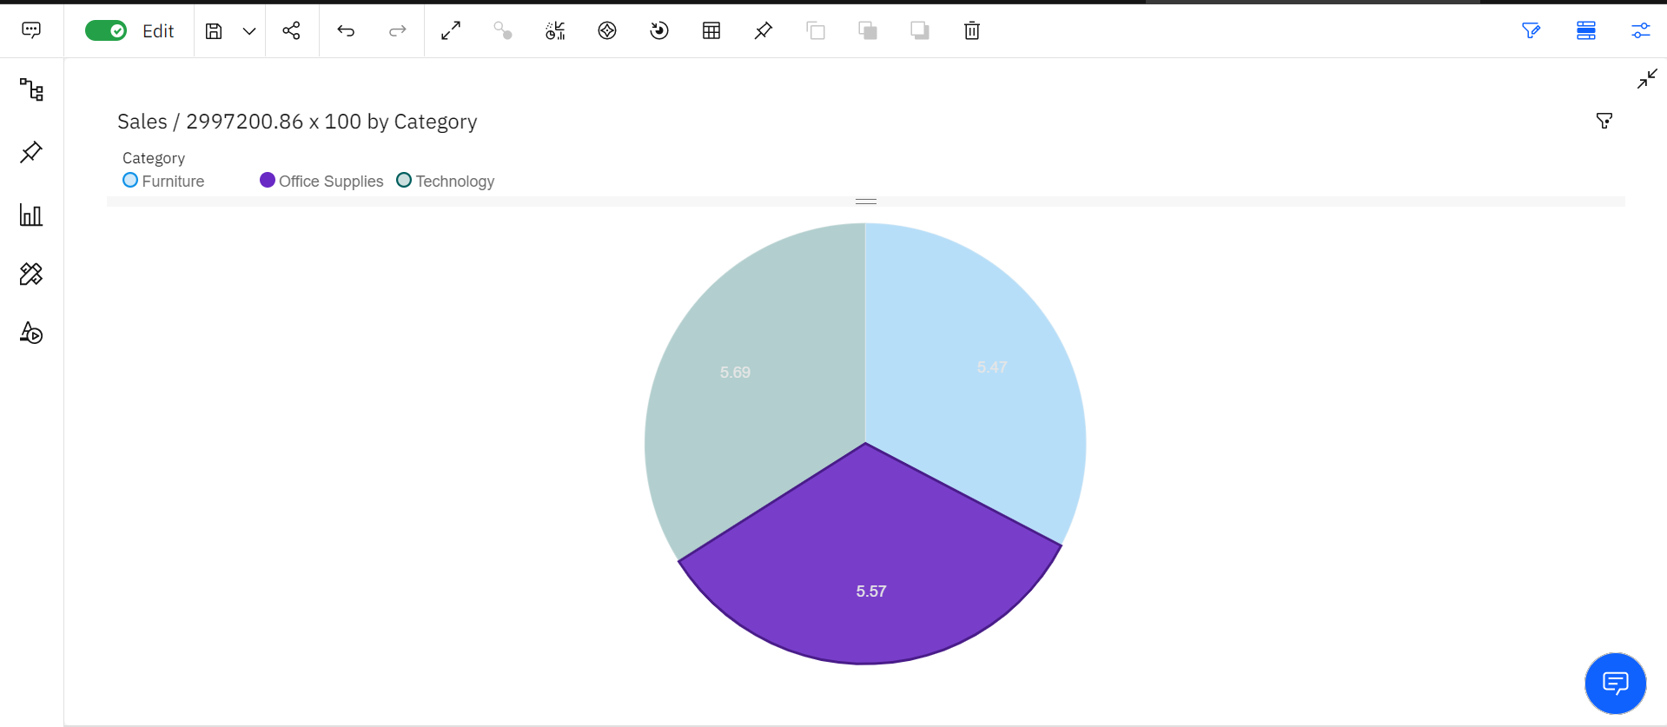
DATA VISUALIZATION CHARTS
Percentage sales by different product categories

Slide 10
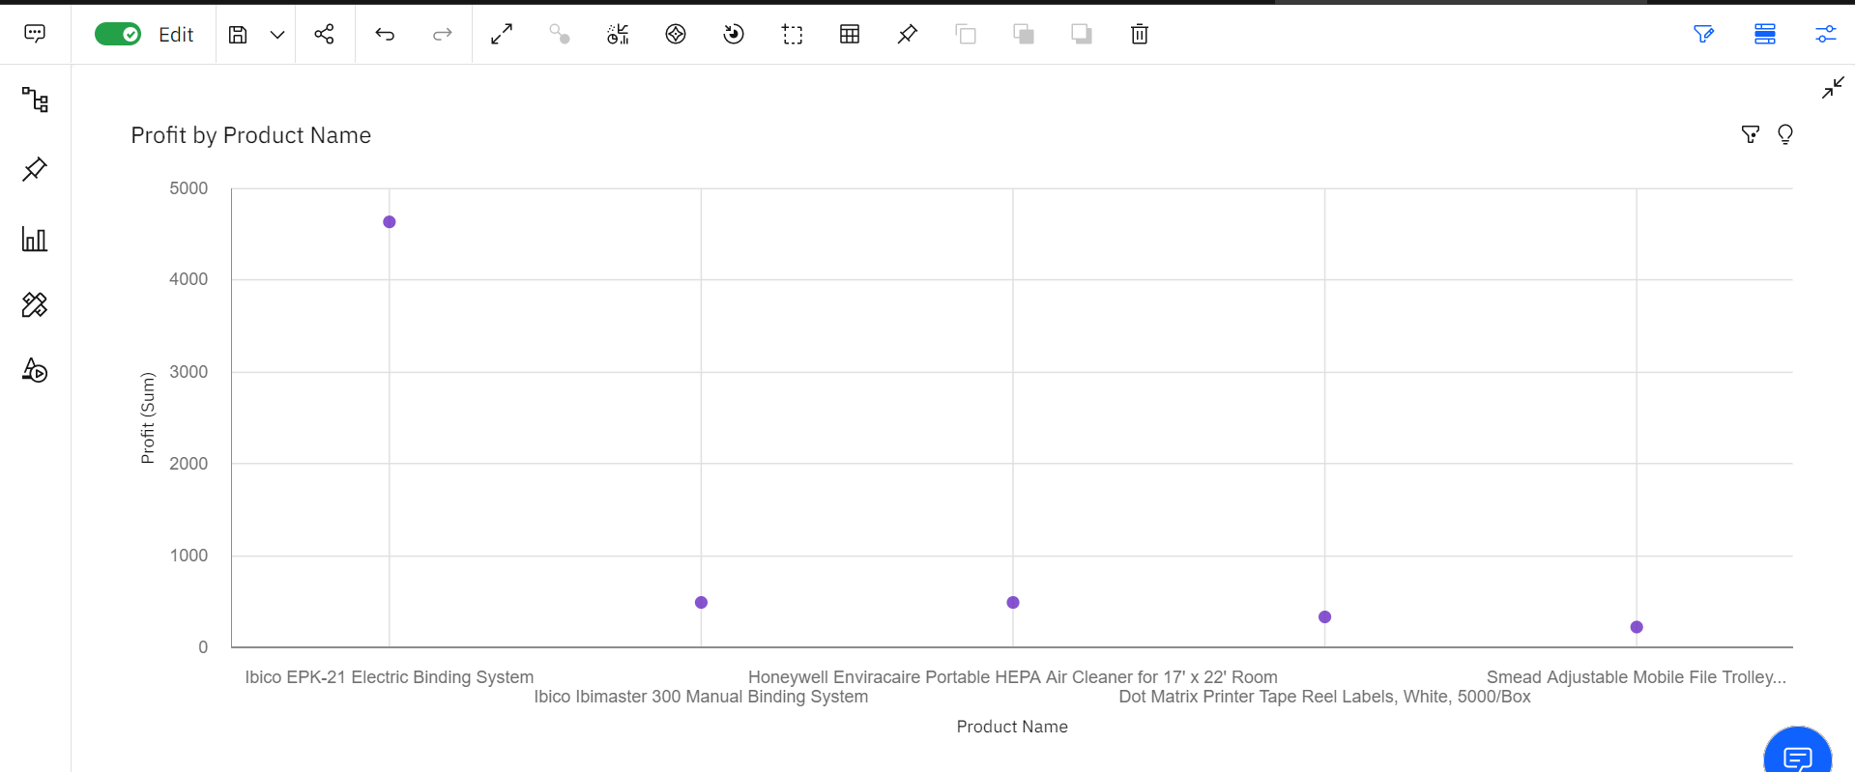
DATA VISUALIZATION CHARTS
Profitable products or their sub products in last few years

Slide 11
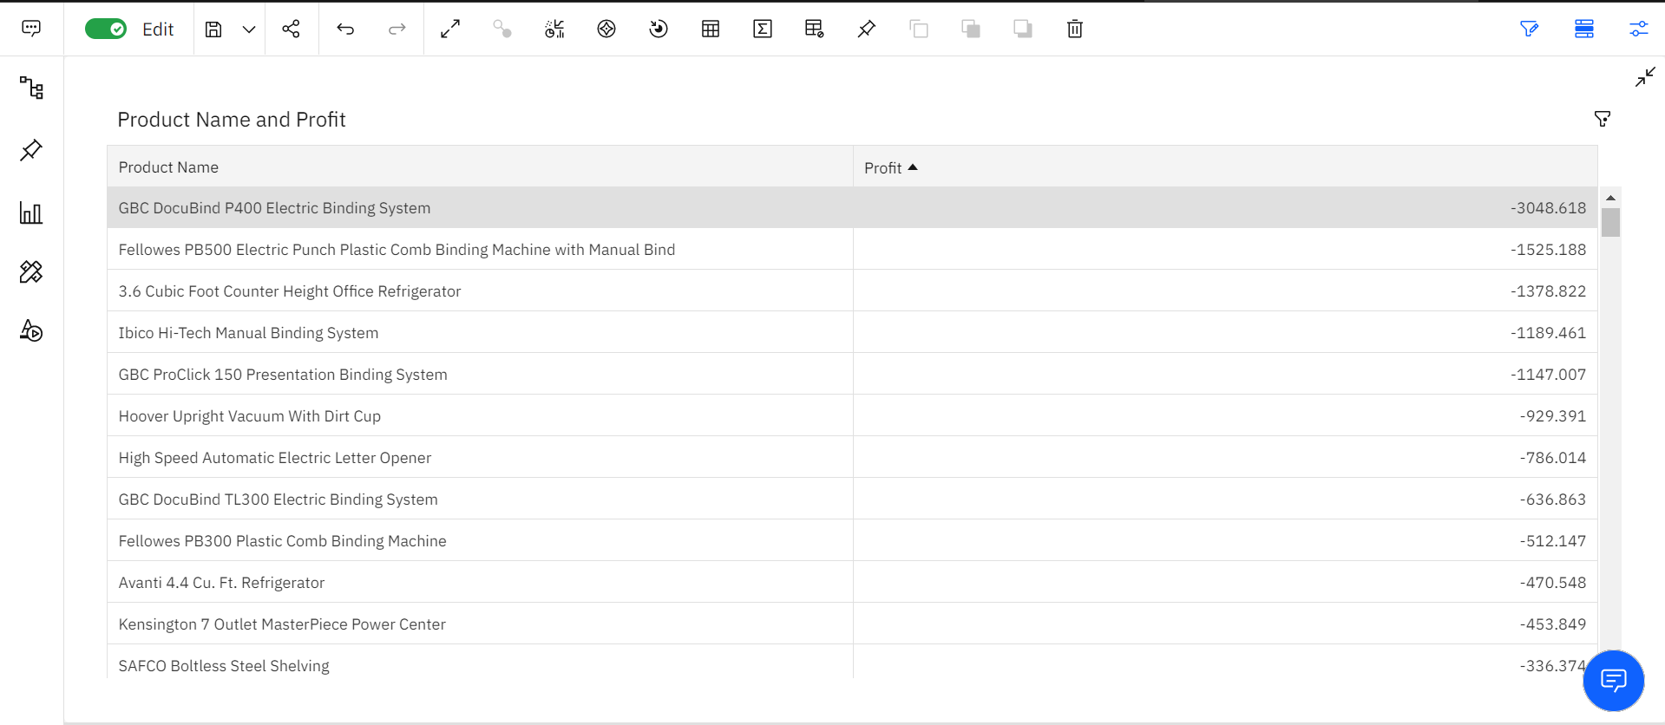
DATA VISUALIZATION CHARTS
Products that incurred losses

Slide 12
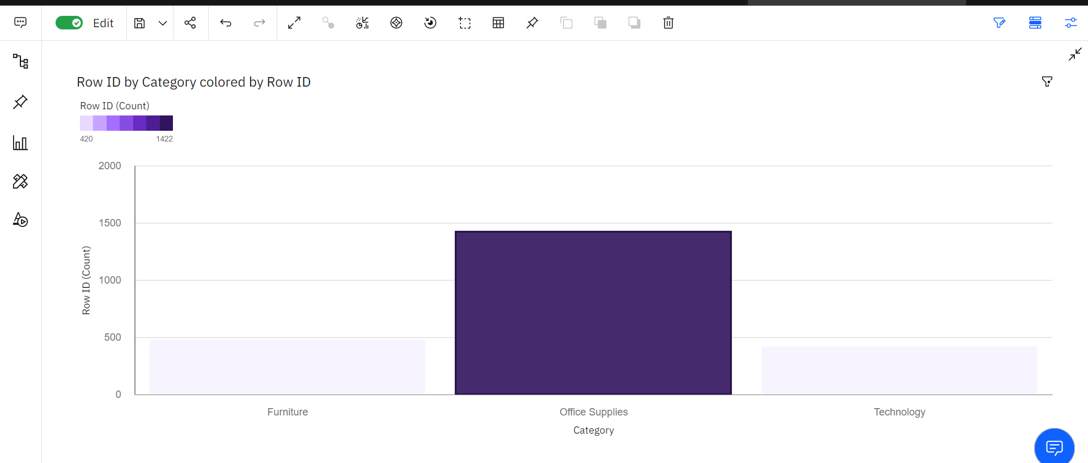
DATA VISUALIZATION CHARTS
Product that was ordered greater times

Slide 13
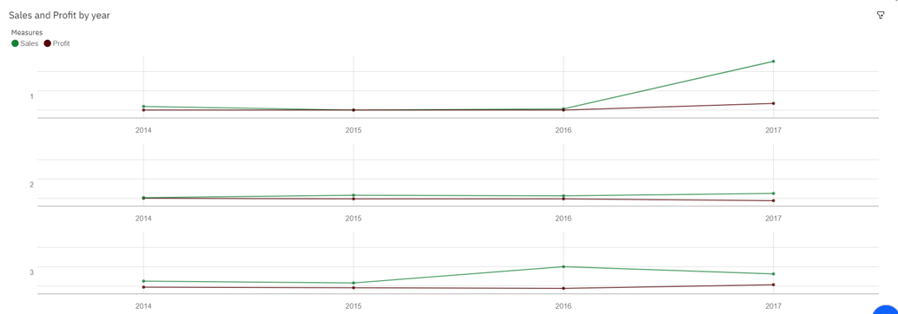
DATA VISUALIZATION CHARTS
Trend in profit/ sales over time ( years/months/quarters)

Slide 14
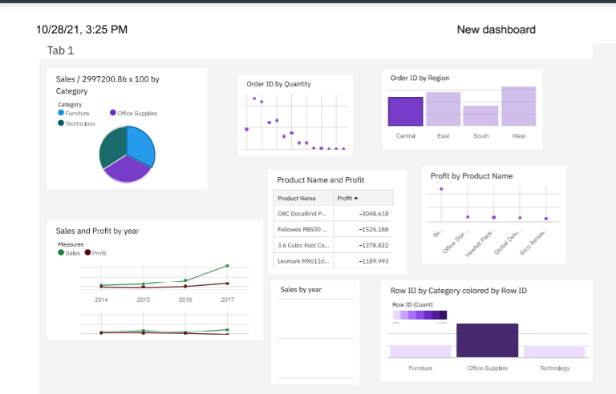
DASHBOARD CREATION
Once you have created views on different tabs in Cognos analytics, you can pull them into a dashboard

Slide 15
SOFTWARE REQUIREMENTS
IBM Congo's Analytics Dashboard
IBM Account
Visualization tools: piechart,bars,bubble,bar-graph etc,,

Slide 16
CONCLUSION
In this project we have presented that we will be analyzing some important visualizations, creating a dashboard and by going through these we will get most of the insights of E- commerce.
By the end of this project you will :
know fundamental concepts and can work on IBM Cognos Analytics.
Gain a broad understanding of plotting different graphs.
Able to create meaningful dashboards

Slide 17
Thank you

